Slide 1
ARM Instruction Set
Part 1
Department of Computer Science and Engineering
Amrita School of Engineering
Coimbatore

Slide 2
Main features of the ARM Instruction Set
All instructions are 32 bits long.
Most instructions execute in a single cycle.
Every instruction can be conditionally executed.
A load/store architecture
  Data processing instructions act only on registers
    Three operand format
    Combined ALU and shifter for high speed bit manipulation
  Specific memory access instructions with powerful auto-indexing addressing modes.
    32 bit and 8 bit data types
      and also 16 bit data types on ARM Architecture v4.
    Flexible multiple register load and store instructions
Instruction set extension via coprocessors

Slide 3
Processor Modes
The ARM has six operating modes:
  User (unprivileged mode under which most tasks run)
  FIQ (entered when a high priority (fast) interrupt is raised)
  IRQ (entered when a low priority (normal) interrupt is raised)
  Supervisor (entered on reset and when a Software Interrupt instruction is executed)
  Abort (used to handle memory access violations)
  Undef (used to handle undefined instructions)
ARM Architecture Version 4 adds a seventh mode:
  System (privileged mode using the same registers as user mode)

Slide 4
Register Example:User to FIQ Mode
Registers in use
Registers in use
User Mode
FIQ Mode
r0
r0
r1
r1
r2
r2
r3
r3
r4
r4
r5
r5
r6
r6
r7
EXCEPTION
r7
r8
r8_fiq
r8
r8_fiq
r9
r9_fiq
r9
r9_fiq
r10
r10_fiq
r10
r10_fiq
r11
r11_fiq
r11
r11_fiq
r12
r12_fiq
r12
r12_fiq
r13 (sp)
r13_fiq
r13 (sp)
r13_fiq
r14 (lr)
r14_fiq
r14 (lr)
r14_fiq
r15 (pc)
r15 (pc)
Return address calculated from User mode
PC value and stored in FIQ mode LR
cpsr
cpsr
spsr_fiq
spsr_fiq
User mode CPSR copied to FIQ mode SPSR

Slide 5
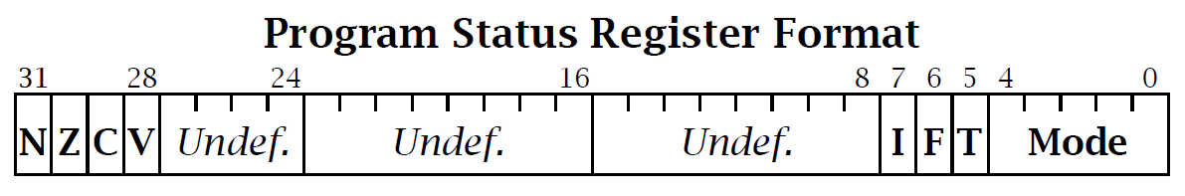
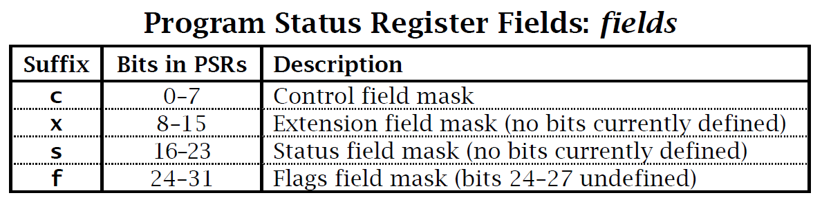

Slide 6
Condition Flags
Logical Instruction Arithmetic Instruction
Flag
Negative No meaning Bit 31 of the result has been set
(N=‘1’) Indicates a negative number in
signed operations
Zero Result is all zeroes Result of operation was zero
(Z=‘1’)
Carry After Shift operation Result was greater than 32 bits
(C=‘1’) ‘1’ was left in carry flag
OVerflow No meaning Result was greater than 31 bits
(V=‘1’) Indicates a possible corruption of
the sign bit in signed
numbers

Slide 7
Flag N - Is set to bit 31 of the result of the instruction.
If this result is regarded as a two’s complement signed integer, then N = 1
If the result is negative and N = 0 if it is positive or zero.
Flag Z - Is set to 1 if the result of the instruction is zero and to 0 otherwise.
This often indicates an equal result from a comparison.

Slide 8
Flag C - Is set in one of four ways:
For an addition, including the comparison instruction CMN, C is set to 1 if the addition produced a carry (that is, an unsigned overflow), and to 0 otherwise.
For a subtraction, including the comparison instruction CMP, C is set to 0 if the subtraction produced a borrow (that is, an unsigned underflow), and to 1 otherwise.
For non-addition/subtractions that incorporate a shift operation, C is set to the last bit shifted out of the value by the shifter.
For other non-addition/subtractions, C is normally left unchanged (but see the individual instruction descriptions for any special cases).

Slide 9
Flag V - Is set in one of two ways:
For an addition or subtraction, V is set to 1 if signed overflow occurred, regarding the operands and result as two’s complement signed integers.
For non-addition/subtractions, V is normally left unchanged (but see the individual instruction descriptions for any special cases).

Slide 10
R15 – Program Counter
When the processor is executing in ARM state:
  All instructions are 32 bits in length
  All instructions must be word aligned
  Therefore the PC value is stored in bits [31:2] with bits [1:0] equal to zero (as instruction cannot be halfword or byte aligned).
R14 is used as the subroutine link register (LR) and stores the return address when Branch with Link operations are performed,
calculated from the PC.
Thus to return from a linked branch
  MOV r15,r14 or MOV pc,lr

Slide 11
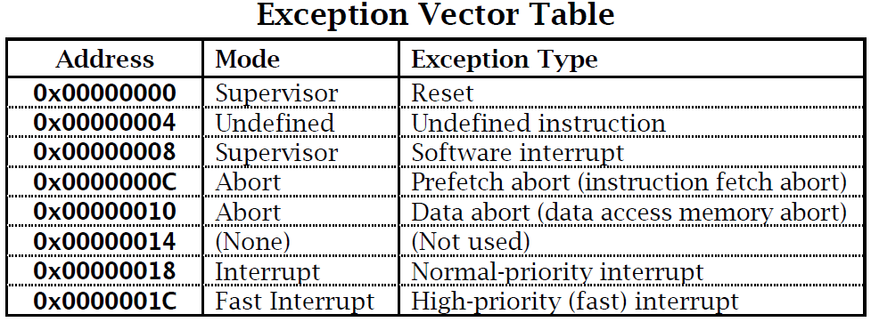
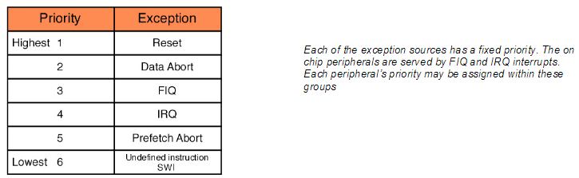

Slide 12
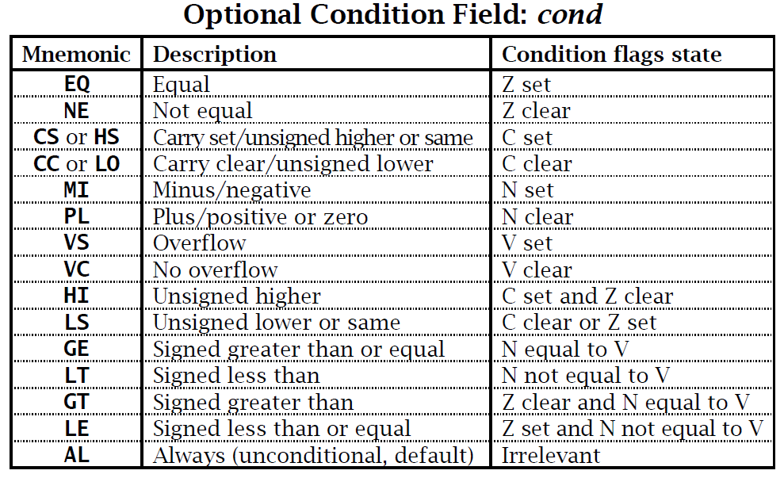

Slide 13
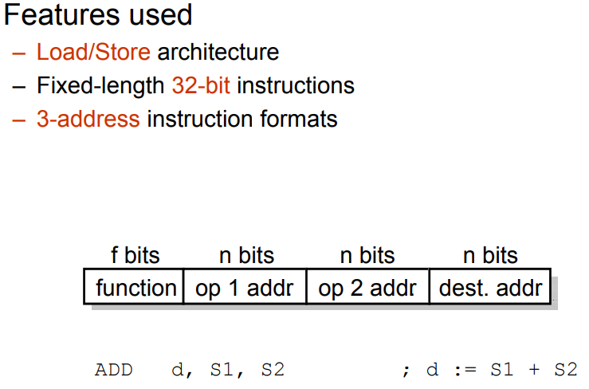

Slide 14
ARM processor is a 32-bit architecture 
Most ARM’s implement two instruction sets
– 32-bit ARM instruction set
–16-bit Thumb instruction set
ARM processor supports 6 data types
– 8-bits signed and unsigned bytes
– 16-bits signed and unsigned half-word, aligned on 2-byte boundaries
– 32-bits signed and unsigned words, aligned on 4-byte boundaries
ARM instructions are all 32-bit words, word-aligned;
Thumb instructions are half-words, aligned on 2- byte boundaries
ARM coprocessor supports floating-point values

Slide 15
Memory

Slide 16
The ARM7TDMI processor views memory as a linear collection of bytes numbered in ascending order from zero. For example:
bytes zero to three hold the first stored word
bytes four to seven hold the second stored word.
The ARM7TDMI processor is bi-endian and can treat words in memory as being stored in either:
Little-endian. traditionally the default format for ARM processors.
Big-endian
Endian configuration has no relevance unless data is stored as words and then accessed in smaller sized quantities (halfwords or bytes).

Slide 17
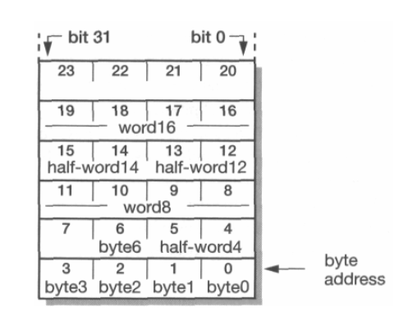

Slide 18
In addition to the processor register state, an ARM system has memory state.
Memory may be viewed as a linear array of bytes numbered from zero up to (2 to the power 32 ) minus 1.
Data items may be 8-bit bytes, 16-bit half-words or 32-bit words.
Words are always aligned on 4-byte boundaries (that is, the two least significant address bits are zero) and half-words are aligned on even byte boundaries.
This shows a small area of memory where each byte location has a unique number.
A byte may occupy any of these locations.
Half-words occupy two byte locations starting at an even byte address.
A word-sized data item must occupy a group of four byte locations starting at a byte address which is a multiple of four.

Slide 19
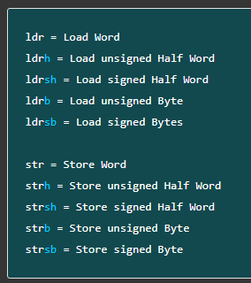


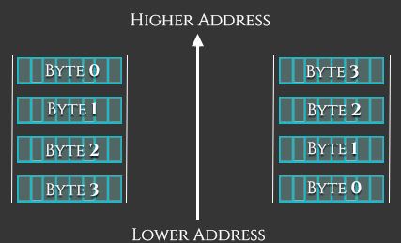
The extensions for these data types are: -h or -sh for halfwords, -b or -sb for bytes, and no extension for words.
The difference between signed and unsigned data types is:
Signed data types can hold both positive and negative values and are therefore lower in range. The range of 2’s complement form is from minus (2^{(n-1)}) to 0 to plus (2^{(n-1)}-1).
Unsigned data types can hold large positive values (including ‘Zero’) but cannot hold negative values and are therefore wider in range. 0 to (2^{n}-1)
Endian – Big or Little ???

Slide 20
Recall Programmer’s View

Slide 21
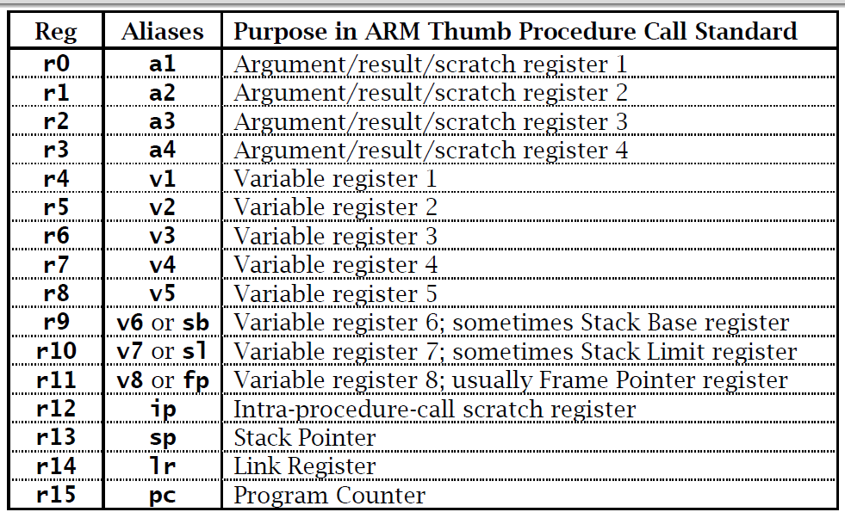
Register Names and Aliases

Slide 22
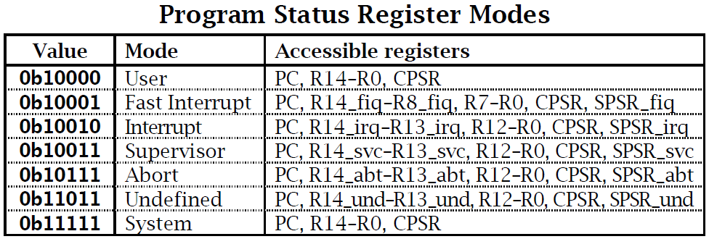

Slide 23
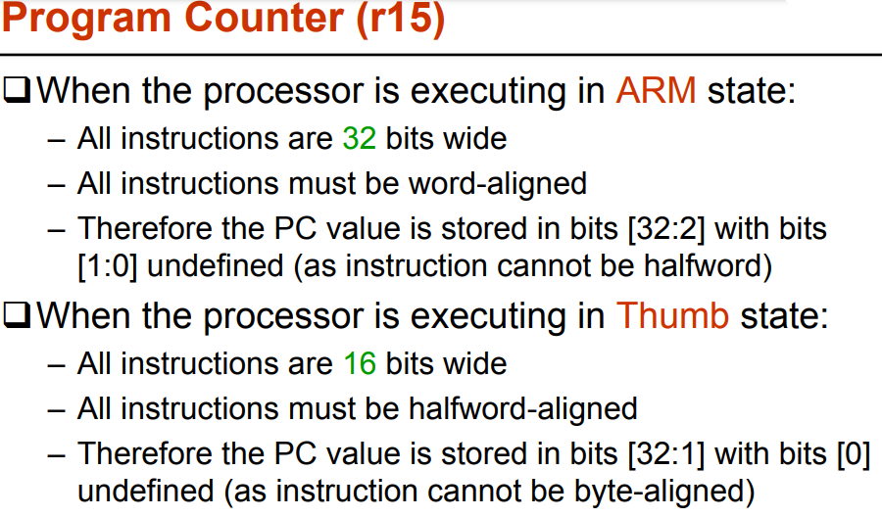

Slide 24
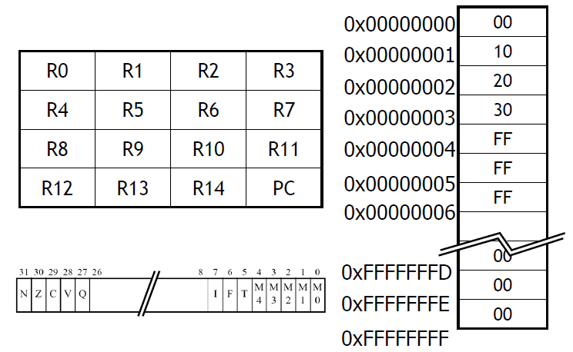
ARM Programmer’s Model

Slide 25
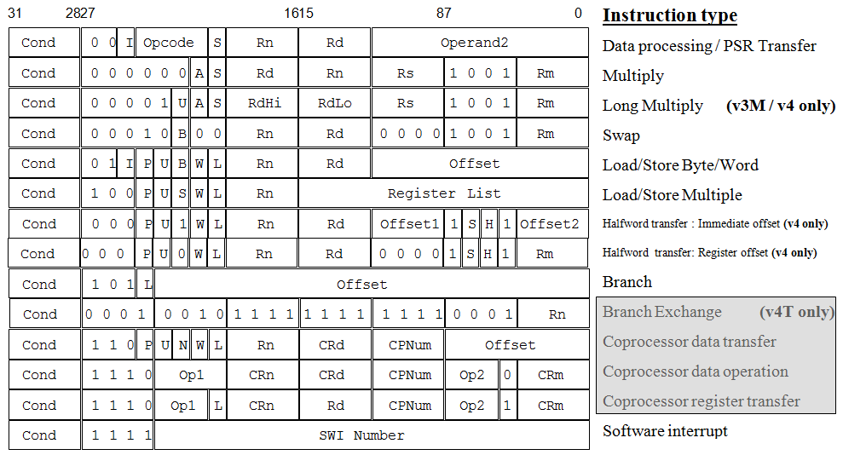
ARM Instruction Set Format

Slide 26
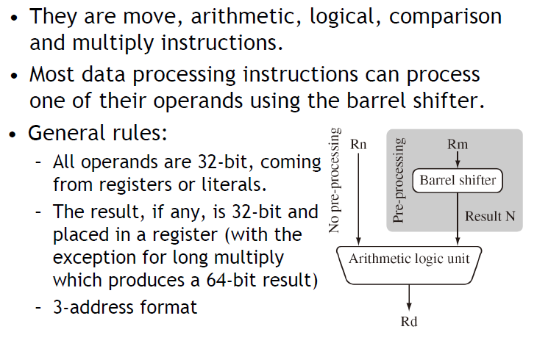
Data Processing

Slide 27
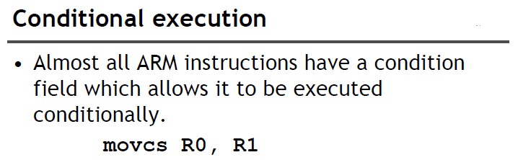

Slide 28
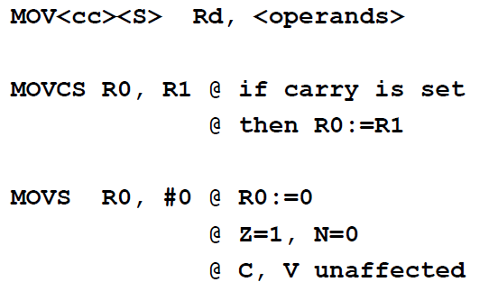

Slide 29
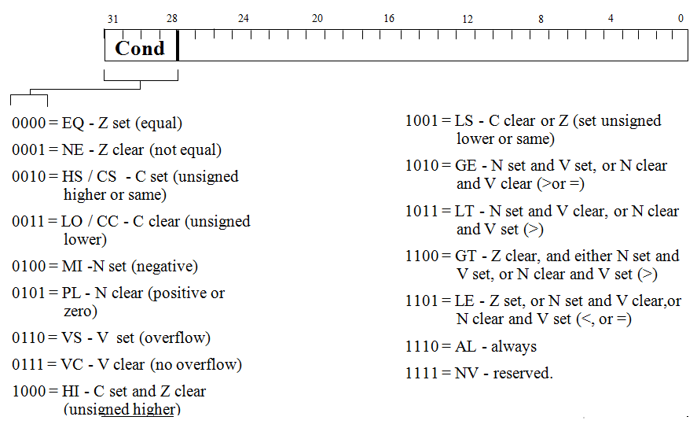
Conditional Fields

Slide 30
Conditional Execution
Most instruction sets only allow branches to be executed conditionally.
However by reusing the condition evaluation hardware, ARM effectively increases number of instructions.
  All instructions contain a condition field which determines whether the CPU will execute them.
  Non-executed instructions soak up 1 cycle.
    Still have to complete cycle so as to allow fetching and decoding of following instructions.
This removes the need for many branches, which stall the pipeline (3 cycles to refill).
  Allows very dense in-line code, without branches.
  The Time penalty of not executing several conditional instructions is frequently less than overhead of the branch
  or subroutine call that would otherwise be needed.

Slide 31
Using and updating the Condition Field
To execute an instruction conditionally, simply postfix it with the appropriate condition:
  For example an add instruction takes the form:
    ADD r0,r1,r2 ; r0 = r1 + r2 (ADDAL)
  To execute this only if the zero flag is set:
    ADDEQ r0,r1,r2 ; If zero flag set then…
    ; ... r0 = r1 + r2
By default, data processing operations do not affect the condition flags (apart from the comparisons where this is the only effect). To cause the condition flags to be updated, the S bit of the instruction needs to be set by postfixing the instruction (and any condition code) with an “S”.
  For example to add two numbers and set the condition flags:
    ADDS r0,r1,r2 ; r0 = r1 + r2 ; ... and set flags

Slide 32
Data processing Instructions
Largest family of ARM instructions, all sharing the same instruction format Contains:
  Arithmetic operations
  Comparisons (no results - just set condition codes)
  Logical operations
  Data movement between registers
Remember, this is a load / store architecture
  These instruction only work on registers, NOT memory.
They each perform a specific operation on one or two operands.
  First operand always a register - Rn
  Second operand Rm sent to the ALU via barrel shifter.
We will examine the barrel shifter shortly.

Slide 33
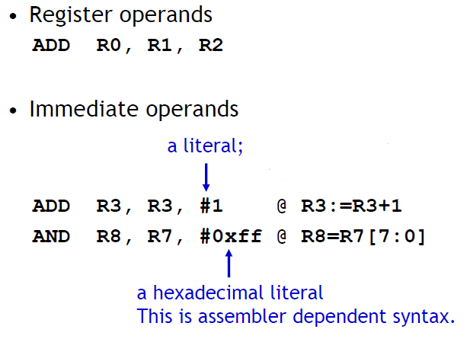

Slide 34
Arithmetic Operations
Operations are:
  ADD operand1 + operand2
  ADC operand1 + operand2 + carry
  SUB operand1 - operand2
  SBC operand1 - operand2 + carry -1
  RSB operand2 - operand1
  RSC operand2 - operand1 + carry - 1
Syntax:
  <Operation>{<cond>}{S} Rd, Rn, Operand2
Examples
  ADD r0, r1, r2
  SUBGT r3, r3, #1
  RSBLES r4, r5, #5

Slide 35
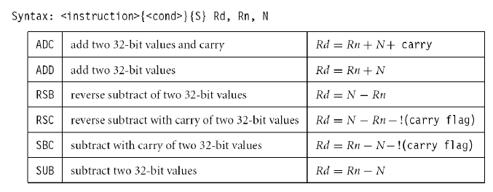
Arithmetic – Add or Subtract

Slide 36
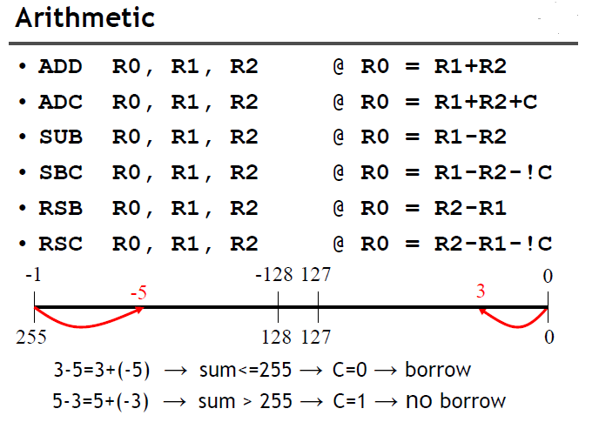
For a subtraction, including the comparison instruction CMP, C is set to 0 if the subtraction produced a borrow (that is, an unsigned underflow), and to 1 otherwise.
https://courses.washington.edu/cp105/02_Exceptions/Status_Registers.html

Slide 37
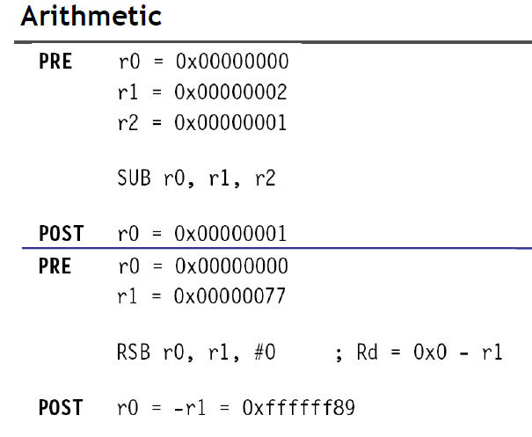

Slide 38
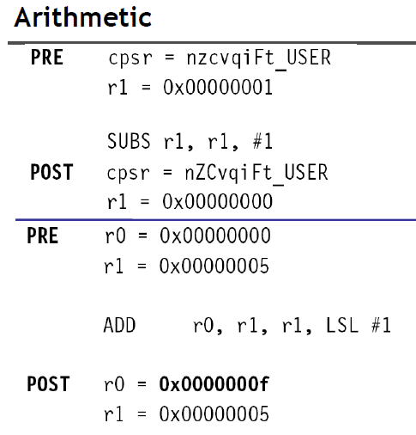

Slide 39
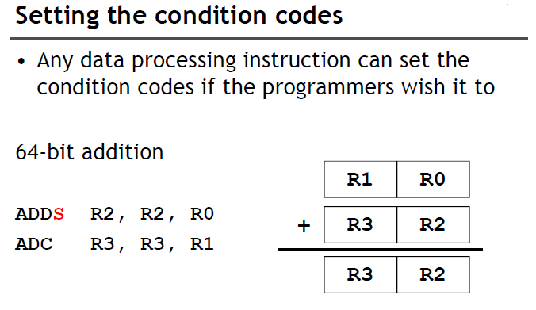

Slide 40
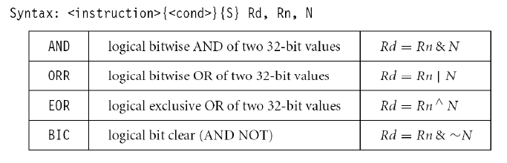
Logical Operation
Operations are:
  AND operand1 AND operand2
  EOR operand1 EOR operand2
  ORR operand1 OR operand2
  BIC operand1 AND NOT operand2 [ie bit clear]
  AND r0, r1, r2
  BICEQ r2, r3, #7
  EORS r1,r3,r0

Slide 41
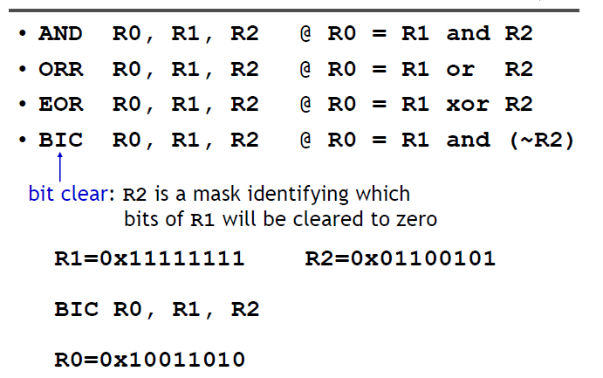
Logical Operation

Slide 42
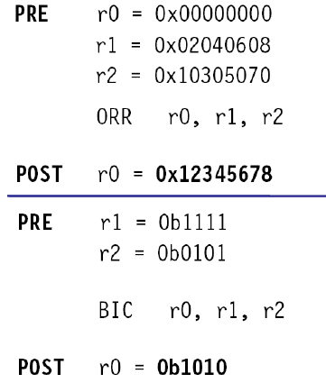
Logical Operation

Slide 43
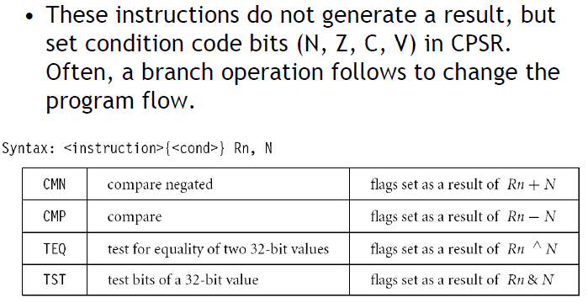
Comparison
The only effect of the comparisons is to
  UPDATE THE CONDITION FLAGS. Thus no need to set S bit.
  CMP r0, r1
  TSTEQ r2, #5

Slide 44
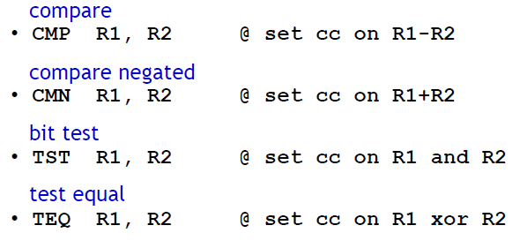
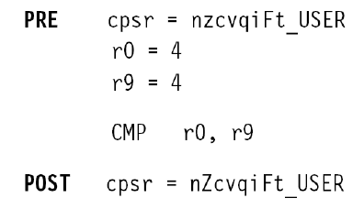

Slide 45
Data Movement
Operations are:
  MOV operand2
  MVN NOT operand2
Note that these make no use of operand1.
Syntax:
  <Operation>{<cond>}{S} Rd, Operand2
Examples:
  MOV r0, r1
  MOVS r2, #10
  MVNEQ r1,#0

Slide 46
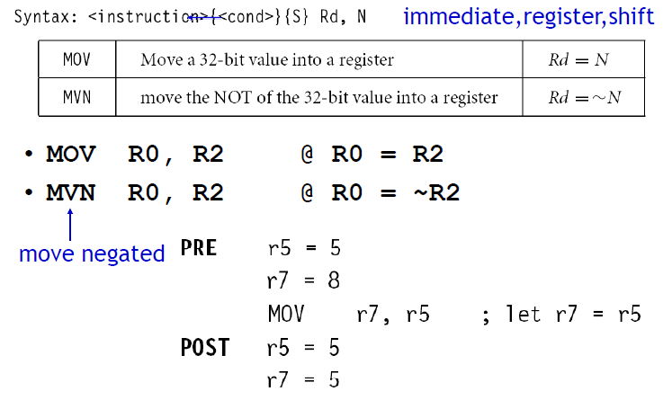

Slide 47
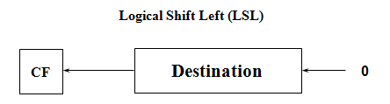
Barrel Shifter
The ARM doesn’t have actual shift instructions.
Instead it has a barrel shifter which provides a mechanism to carry out shifts as part of other instructions.
So what operations does the barrel shifter support?
Shifts left by the specified amount (multiplies by powers of two) e.g.
  LSL #5 = multiply by 32

Slide 48
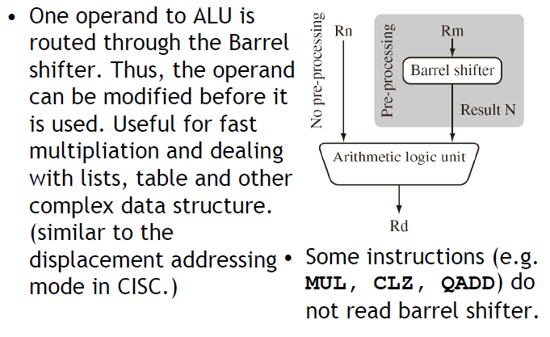

Slide 49
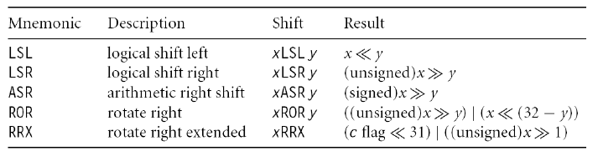

Slide 50
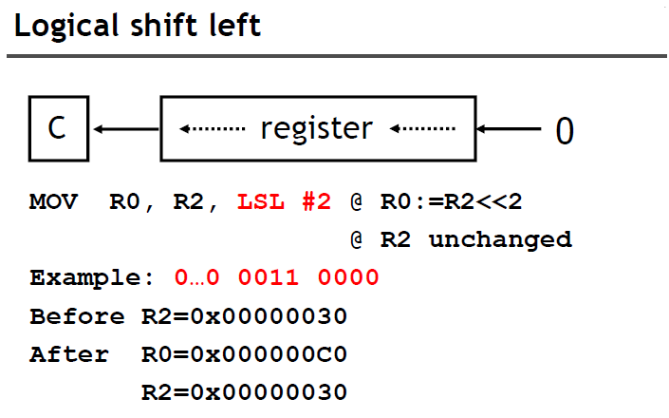
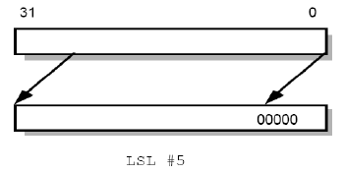

Slide 51
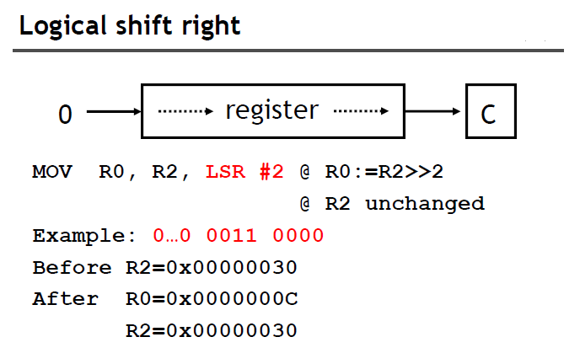
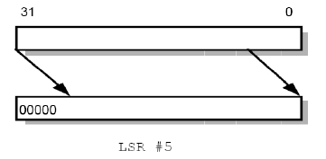

Slide 52
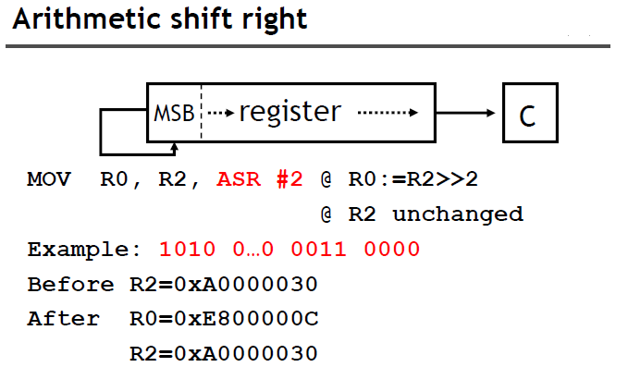
Before ASR 0x A0 00 00 30 = > 0b 1010 0000 0000 0000 0011 0000
After ASR by 1 bit 0xD0 00 00 08 => 0b 1101 0000 0000 0000 0001 1000
After ASR by another 1 bit 0xE8 00 00 0C => 0b 1110 1000 0000 0000 0000 1100

Slide 53
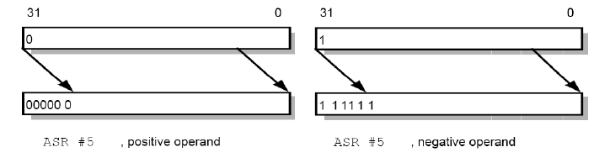
ASR – Positive and Negative Operand

Slide 54
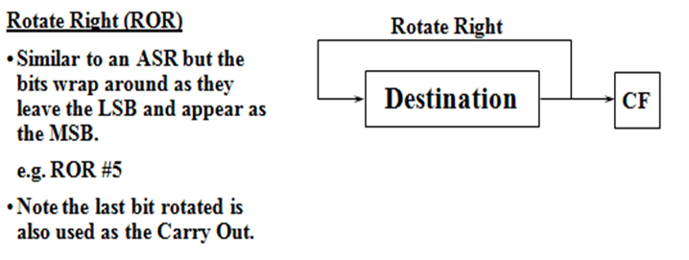
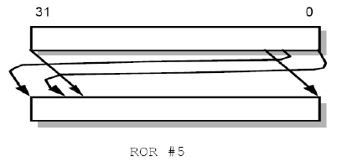
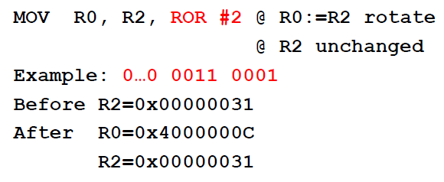

Slide 55
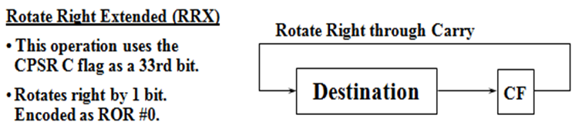
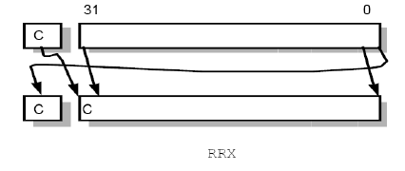
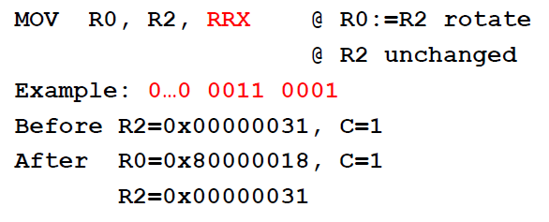

Slide 56
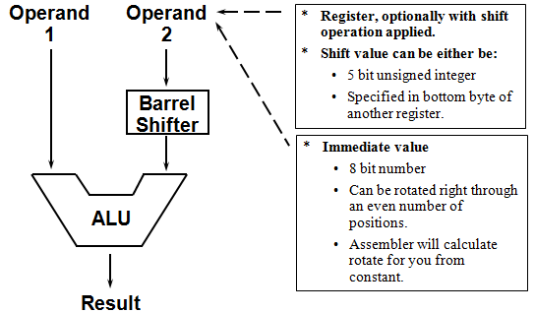
Using the Barrel Shifter – the Second Operand

Slide 57
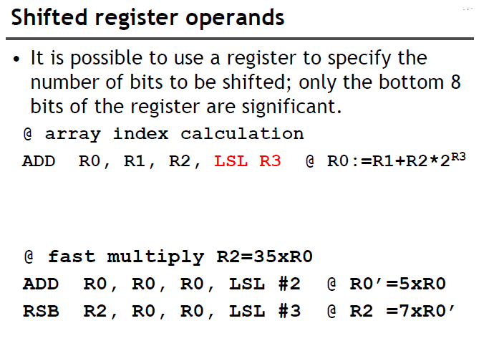

Slide 58
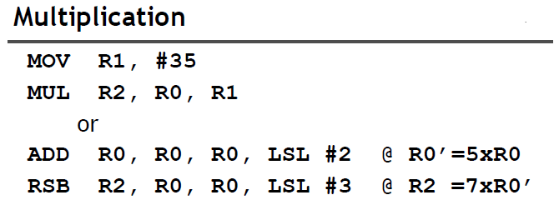

Slide 59

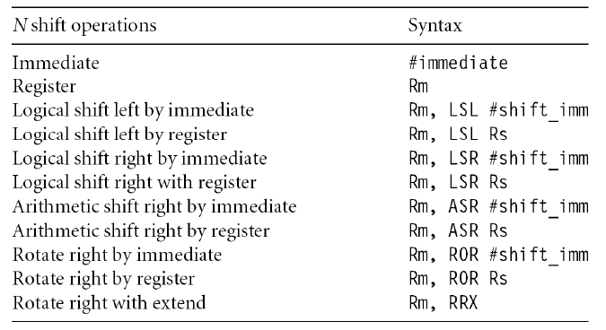

Slide 60


Slide 61
Second Operand : Shift Register
The amount by which the register is to be shifted is contained in either:
  the immediate 5-bit field in the instruction
    NO OVERHEAD
    Shift is done for free - executes in single cycle.
  the bottom byte of a register (not PC)
    Then takes extra cycle to execute
    ARM doesn’t have enough read ports to read 3 registers at once.
    Then same as on other processors where shift is
    separate instruction.
If no shift is specified then a default shift is applied: LSL #0
  i.e. barrel shifter has no effect on value in register.

Slide 62
Second Operand : using a Shift Register
Using a multiplication instruction to multiply by a constant means first loading the constant into a register and then waiting a number of internal cycles for the instruction to complete.
A more optimum solution can often be found by using some combination of MOVs, ADDs, SUBs and RSBs with shifts.
  Multiplications by a constant equal to a ((power of 2) ± 1) can be done in one cycle.
Example: r0 = r1 * 5
Example: r0 = r1 + (r1 * 4)
⇦ ADD r0, r1, r1, LSL #2
Example: r2 = r3 * 105
Example: r2 = r3 * 15 * 7
Example: r2 = r3 * (16 - 1) * (8 - 1)
⇦ RSB r2, r3, r3, LSL #4 ; r2 = r3 * 15
⇦ RSB r2, r2, r2, LSL #3 ; r2 = r2 * 7

Slide 63
Second Operand : Immediate Value
There is no single instruction which will load a 32 bit immediate constant into a register without performing a data load from memory.
  All ARM instructions are 32 bits long
  ARM instructions do not use the instruction stream as data.
The data processing instruction format has 12 bits available for operand2
  If used directly this would only give a range of 4096.
Instead it is used to store 8 bit constants, giving a range of 0 - 255.
These 8 bits can then be rotated right through an even number of positions (ie RORs by 0, 2, 4,..30).
  This gives a much larger range of constants that can be directly loaded, though some constants will still need to be loaded
  from memory.

Slide 64
Second Operand : Immediate Value
This gives us:
  0 - 255 [0 - 0xff]
  256,260,264,..,1020 [0x100-0x3fc, step 4, 0x40-0xff ror 30]
  1024,1040,1056,..,4080 [0x400-0xff0, step 16, 0x40-0xff ror 28]
  4096,4160, 4224,..,16320 [0x1000-0x3fc0, step 64, 0x40-0xff ror 26]
These can be loaded using, for example:
  MOV r0, #0x40, 26 ; => MOV r0, #0x1000 (ie 4096)
To make this easier, the assembler will convert to this form for us if simply given the required constant:
  MOV r0, #4096 ; => MOV r0, #0x1000 (ie 0x40 ror 26)
The bitwise complements can also be formed using MVN:
  MOV r0, #0xFFFFFFFF ; assembles to MVN r0, #0
If the required constant cannot be generated, an error will
be reported.

Slide 65
Loading Full 32 bit constants
Although the MOV/MVN mechanism will load a large range of constants into a register, sometimes this mechanism will not generate the required constant.
Therefore, the assembler also provides a method which will load ANY 32 bit constant:
  LDR rd,=numeric constant
If the constant can be constructed using either a MOV or MVN then this will be the instruction actually generated.
Otherwise, the assembler will produce an LDR instruction with a PC-relative address to read the constant from a literal pool.
  LDR r0,=0x42 ; generates MOV r0,#0x42
  LDR r0,=0x55555555 ; generate LDR r0,[pc, offset to lit pool]
As this mechanism will always generate the best instruction for a given case, it is the recommended way of loading constants.

Slide 66
End of Session

